Slide 1

Unemployment
A gift that I hope keeps on giving

Slide 2

History
Joe Berry
Maria Maisto
New Faculty Majority
NEA
RAFO
http://chicagococal.org/downloads/Access_to_Unemployment_Insurance_Benefits.pdf

Slide 3
Strategy resumed
Idea for filing parties came up at Illinois Higher Education Conference Oct. 2007
  Got funding through NEA Contingent Action Plan
  NEA also joined AFT and AAUP in funding publication of “Access to Unemployment Insurance…” booklet
Two major parts of strategy
  “Filing parties” (group mobilization)
  Legislative (change the law in Illinois)
  Court challenge seen as fruitless
  Both parts of strategy require mobilizing parent unions

Slide 4
Strategy …
After training in March 2008, first parties held in May 2008
  Basically info sessions – build awareness among contingent faculty and offer practical advice on how to file
  Tried to be clear about difficulties, but some expected it to be easy
  Got wriiten advice from IEA on how to handle appeals
Goals
  Get benefits for some (the lucky few)
  Put “sand in the gears” for the Illinois Department of Employment Security
  Builds up evidence of demand for benefits and injustice of routine denial
  More people apply less likely for retaliatiion

Slide 5
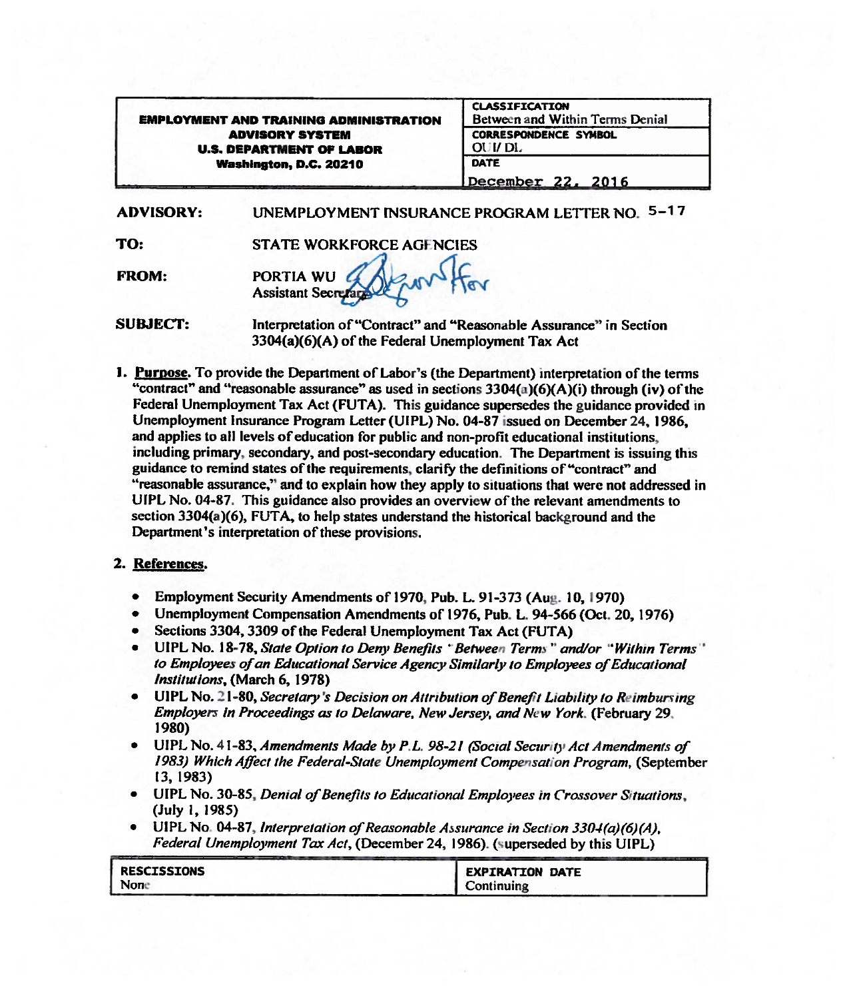
Department of Labor Unemployment Letter 5-17

Slide 6
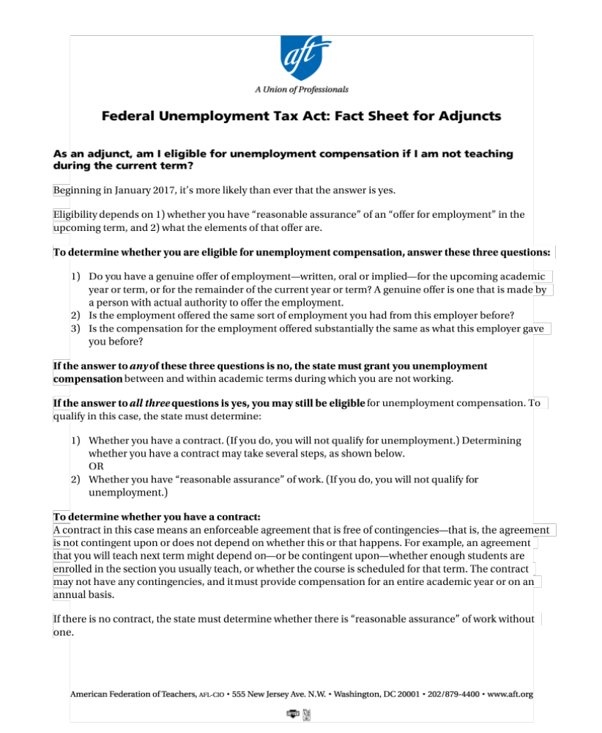
Q and A by AFT
http://www.aft.org/sites/default/files/qa_adjuncts_unemployment.pdf?link_id=14&can_id=fa735f540394f202f72a4c395325a1c3&source=email-faculty-to-trump-handsoffourcampus&email_referrer=faculty-to-trump-handsoffourcampus&email_subject=faculty-to-trump-handsoffourcampus

Slide 7
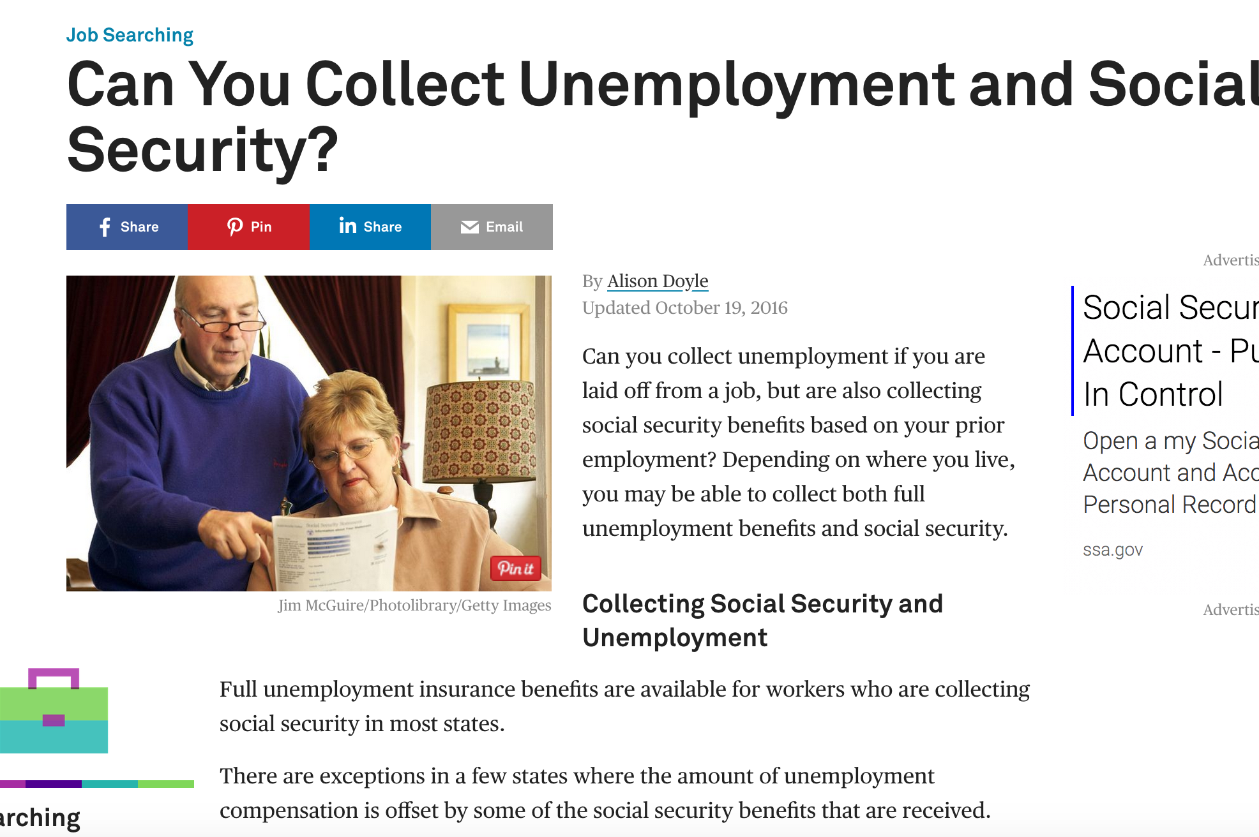
https://www.thebalance.com/can-you-collect-unemployment-and-social-security-2064151

Slide 8
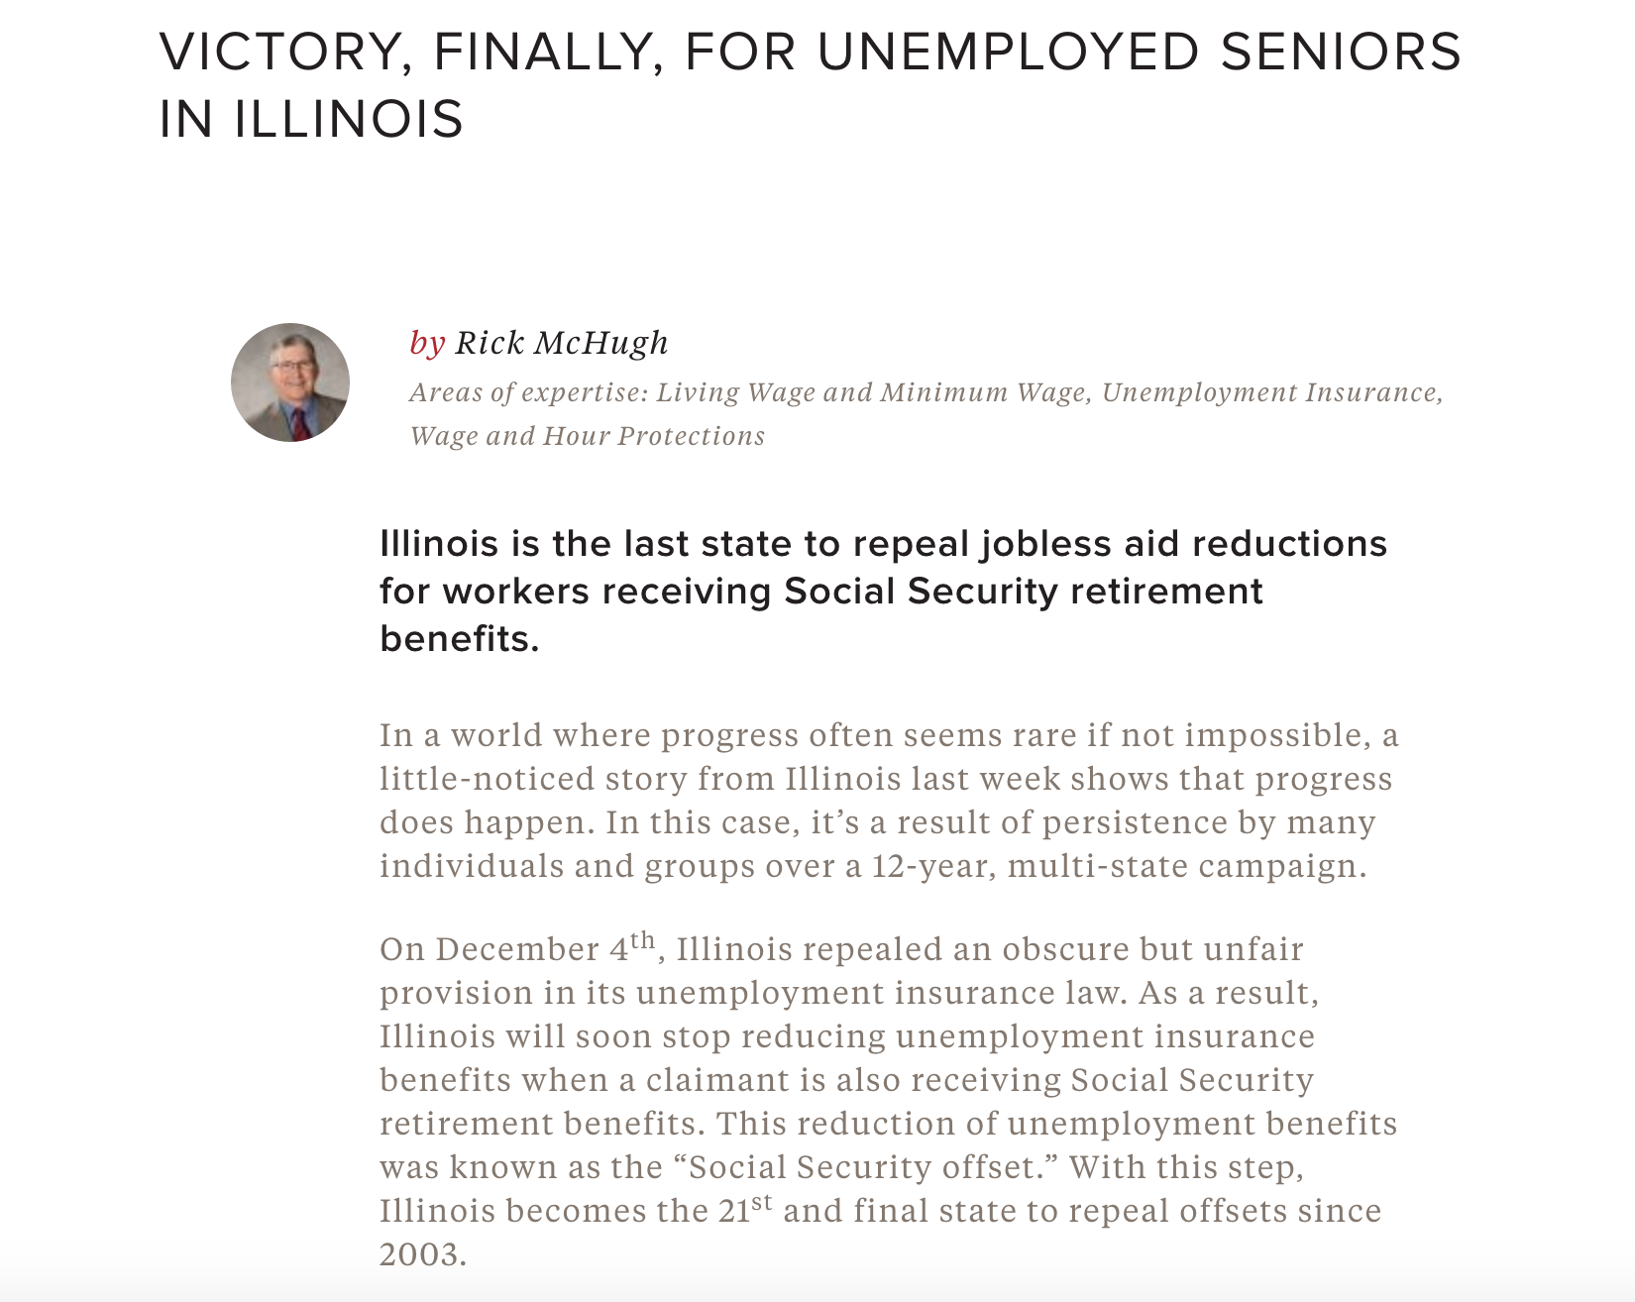
http://www.nelp.org/blog/victory-finally-for-unemployed-seniors-in-illinois/

Slide 9
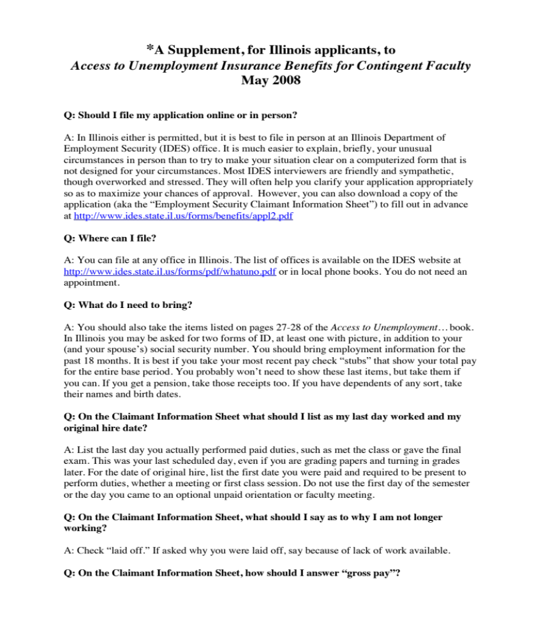
Filing Guide Sheet
http://chicagococal.org/downloads/IllinoisSupplementFAQ-2008-0509.pdf

Slide 10
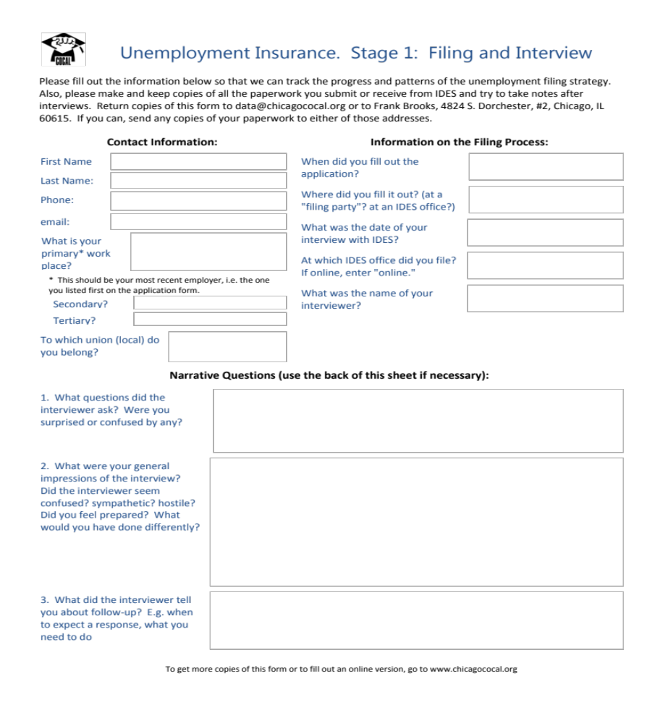
Survey
Questions
http://chicagococal.org/downloads/UI-strategy-stage1-survey.pdf

Slide 11
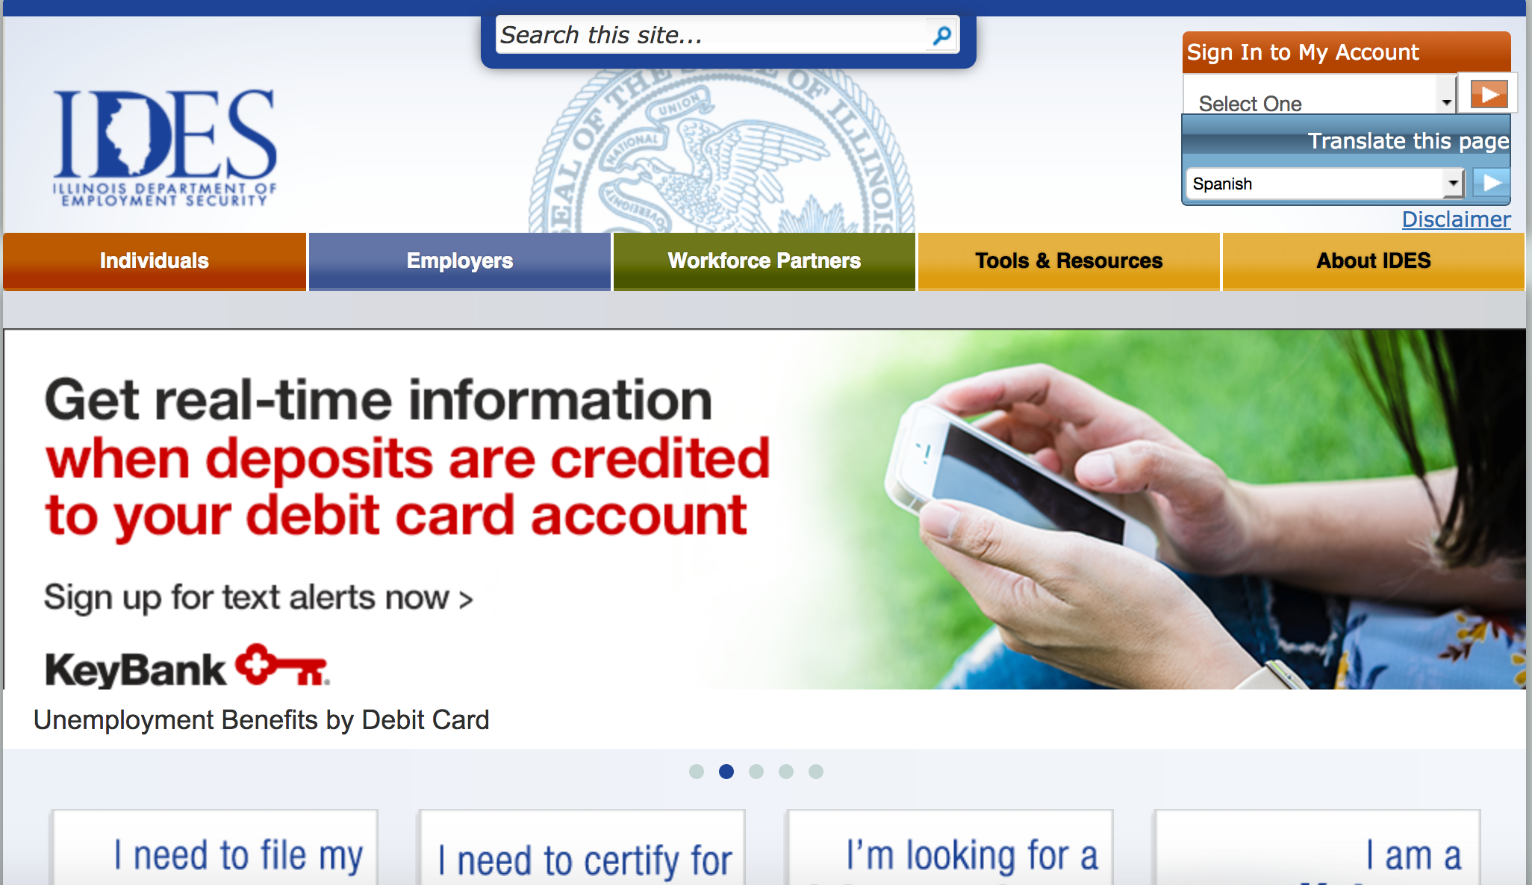
Let’s Get Started
http://www.ides.illinois.gov/Pages/default.aspx

Slide 12
Contact us with your story
ides.ecreports@gmail.com

