Slide 1
2010 Gubernatorial Election
A Tale of Two Candidates
2010 NEA Convention
IEA Delegate Caucus Meeting &
IEA Board Meeting

Slide 2
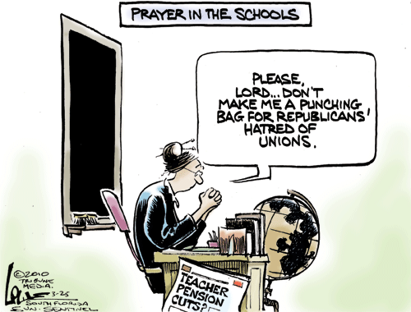

Slide 3
What Happened ?
Imposition of a reduced retirement benefits system for new members
Defeated Voucher proposal for Chicago schools
Assisted State Board in application for Race to the Top grant
Passed legislation allowing for higher ed borrowing
Passage of bill requiring teachers to administer medication to students.

Slide 4
What Could Happen?
Erosion of pension benefits for current members
Establishment of a Voucher program
No significant additional revenue for the state
Elimination of tenure protections
Erosion of the Collective Bargaining Law
Loss of Right to Strike

Slide 5
Issue: School Funding
Candidate A
Candidate B
Opposed to an increase in personal or corporate income tax
Opposed to a progressive tax system
Supports rolling back taxes & fees imposed by previous administration.
Supports an increase in the personal and corporate income tax
Supports a progressive tax system
Supports property tax relief and an increase in the personal exemption for individuals.

Slide 6
Issue: Pensions
Candidate A
Candidate B
Supports fully funding the 5 retirement systems
Supports reduced retirement benefits for current employees
Supports defined contribution plan for new state employees.
Supports fully funding the 5 retirement systems
Opposes any reduction of current employee retirement benefits
Opposed to a defined contribution plan for state employees.

Slide 7
Issue: Labor Issues
Candidate A
Candidate B
Supports Illinois becoming a right to work state; Prohibits collective bargaining and strikes
Advocate for reduction of Illinois’ minimum wage
Opposed equal pay for men and women
Fully supports the Collective Bargaining Act
Supports Illinois’ minimum wage at the current
Proclamation for Equal Pay Day; April 20, 2010

Slide 8
Issue: Education
Candidate A
Candidate B
Supported Race to the Top
Proposed elimination of the State Board of Education
Supports imposition of vouchers statewide.
Supports Race to the Top
Vows to veto voucher proposal if it comes to his desk
Supports full funding of the State Board of Education.

Slide 9
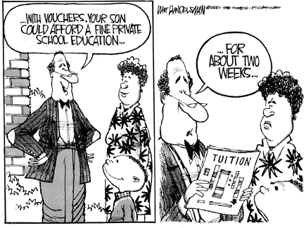

Slide 10
Stay or Play?
When IEA endorses a candidate, it has a net positive impact on IEA members’ views of the candidate.
Over half of the members (51%) say an IEA endorsement would make them “much more” likely or “somewhat” more likely to vote for a candidate.

Slide 11
Support for IEA Endorsement

Slide 12
Rasmussen Polling
June 7th Survey
  Senator Brady: 47%
  Governor Quinn: 36%
  Some other candidate: 8%
  Not sure: 10%
  Survey of 500 Illinois Likely Voters

Slide 13
Who’s on the Ballot?
Republican: Bill Brady & Jason Plummer
Democrat: Pat Quinn & Sheila Simon
Green: Rich Whitney & Don Crawford
Independent: Scott Cohen & Baxter Swilley
Libertarian: Lex Green & Ed Rutledge
Constitution: Michael White & Jeff Trexler

